Slide 1

Futuristic

Slide 2



To find a better Accommodation for the guests in Berlin based on their requirements.
To improve the Host’s business in Airbnb Berlin
M
O
T
I
V
A
T
I
O
N

Slide 3


Topics Covered in Presentation
Data Sources
Data Clean up & Exploration
Data Analysis
Outcomes/Take Aways
Conclusion
Future Work
References

Slide 4


Data Sources
Source Data
API Data
https://www.kaggle.com/brittabettendorf/berlin-airbnb-data
http://insideairbnb.com/get-the-data.html
https://api.yelp.com/v3/businesses/search
https://maps.googleapis.com/maps/api/geocode/json?

Slide 5

Data Sources Description
Source Data :
The Kaggle datasets were scraped on November 07th, 2018 and contains the detailed listings data, review data and calendar data of current Airbnb listings in Berlin from 2008 to 2018.
The Kaggle datasets were scraped from the insideairbnb.com source. The latest scrapped was on 8th June, 2019. ( We will be using the 8th June 2019 data for our analysis which had around 25k listings from 2008 to 2019. )
API Data :
We have used the yelp and google api to retrieve the top ratings restaurants/café/bars around the top accommodations in berlin. And also for calculating the Berlin Central, Airport & Railway distance.

Slide 6
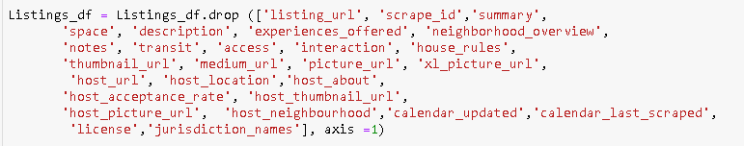
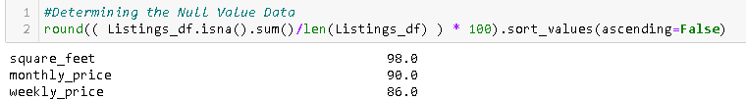
Data Clean Up & Exploration
There were around 106 features in Airbnb Listing Dataset consisting of various descriptive, categorical, numerical, Boolean, etc. fields. Few fields in the dataset had its own limitations. Below are the few data cleaning process implemented using Pandas as part of this Dataset.
Few unnecessary columns were dropped in the Listing Data frame which were not used as part of analysis. (By just seeing the data)
The below columns were dropped because it had more than 85% of null values.

Slide 7
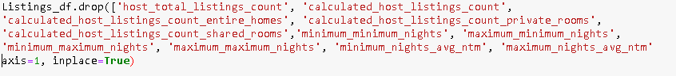
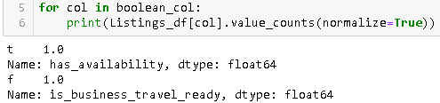
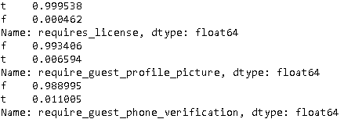
Data Clean Up & Exploration (cont..)
Similar type of columns were dropped by just keeping the important column.
Locations related columns which had similar values in all the rows were dropped.
Boolean Columns which had just 1 category values were dropped.

Slide 8
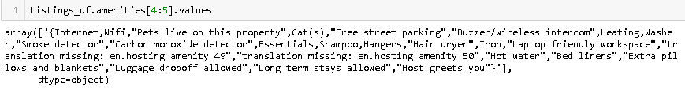
Data Clean Up & Exploration (cont..)
Amenities Column were stored as one big block of text.
Date Columns were converted to date time format.
Price Related Columns were stored as string with dollar signs and comma separated values.
Similar column values were replaced with the respective values for a better plot. (for ex. Property type, Cancellation policy”)
Used Reverse Geocoder to retrieve the exact place name using Latitude & Longitude

Slide 9
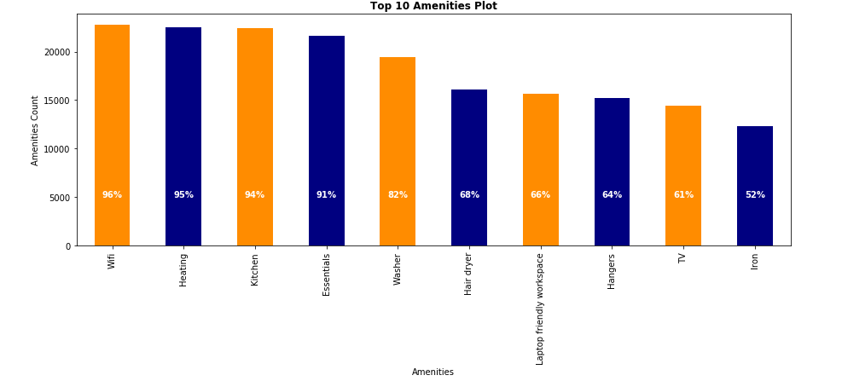
Data Analysis : Factors for Business Growth

Slide 10
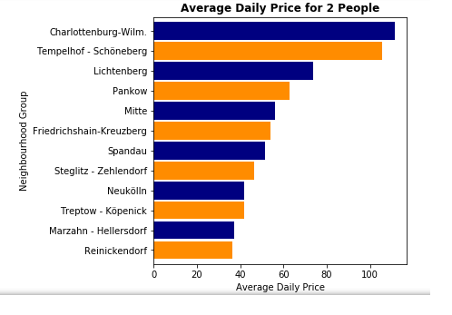
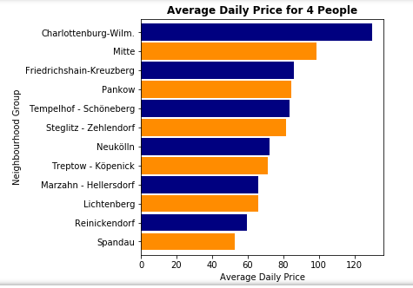

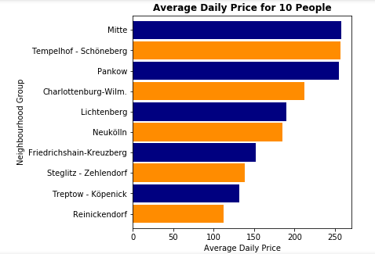
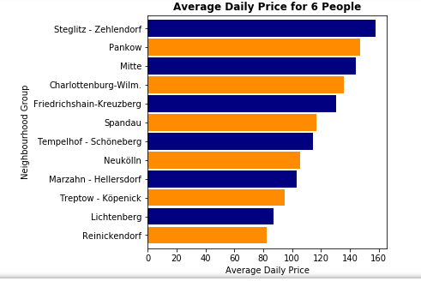

Slide 11
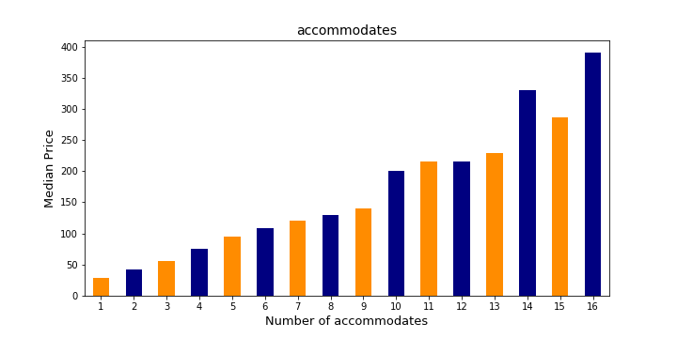
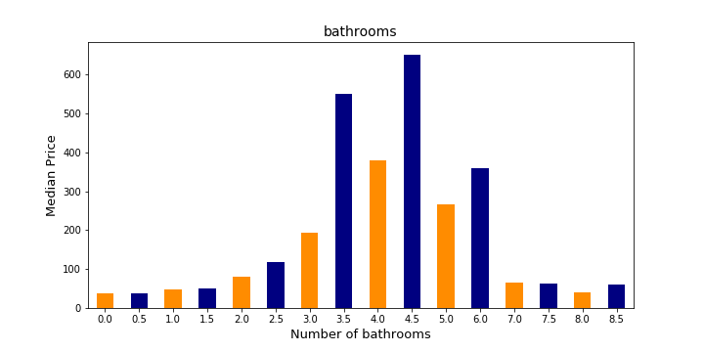

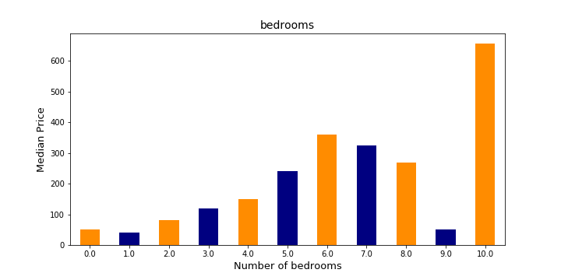
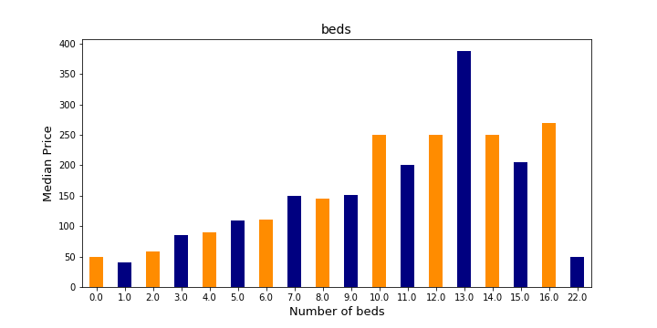

Slide 12
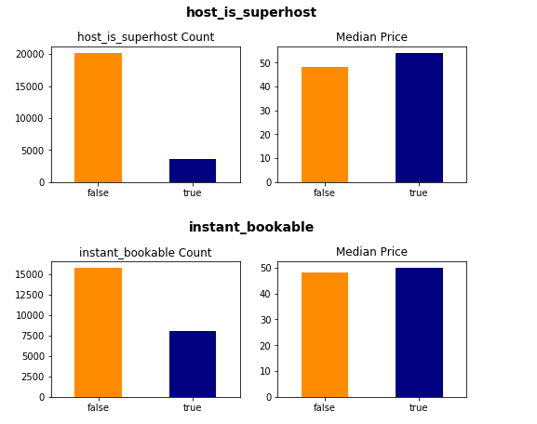
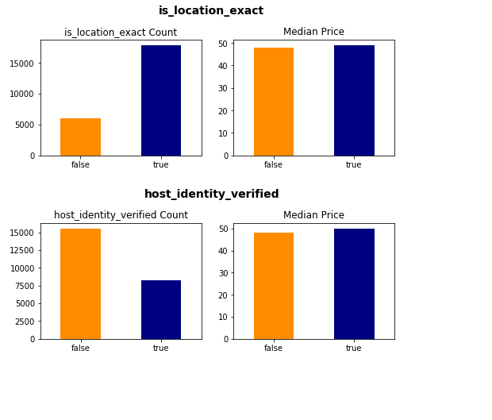
Data Analysis : Boolean Features Vs Price
Does the Hosts really need the below Features?

Slide 13
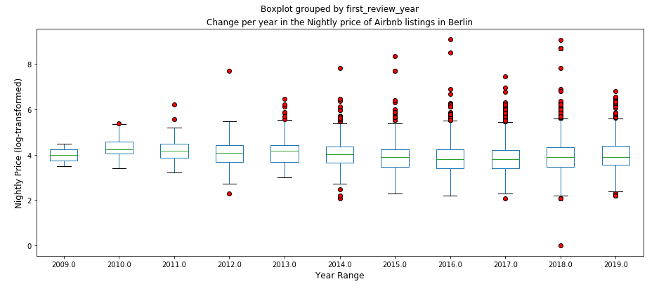
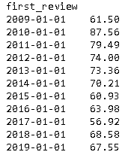
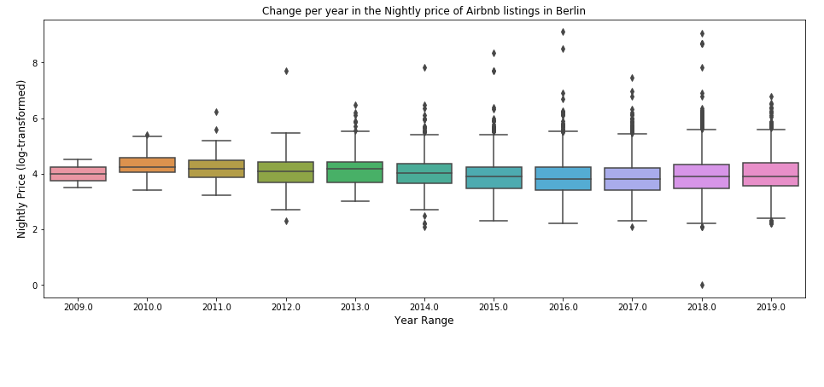
Data Analysis : How Have Prices Changed over time?

Slide 14
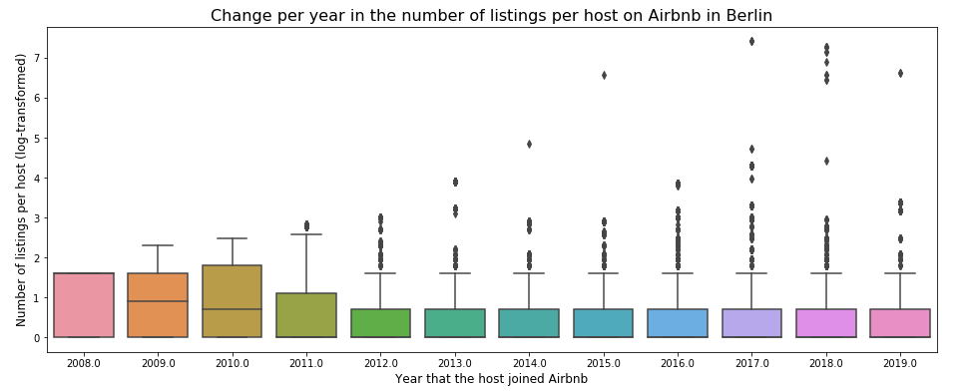
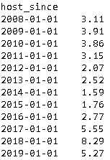
Data Analysis : Change per year in the number of listings per host on Airbnb in Berlin

Slide 15
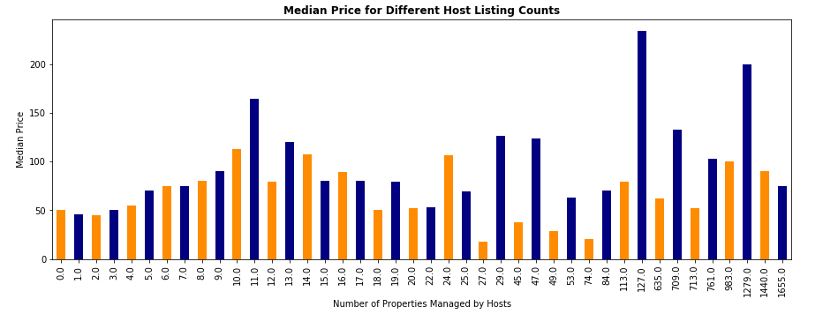
How many other listings the host manages in Airbnb?
Does it mean Hosts having more properties will gain higher prices??

Slide 16
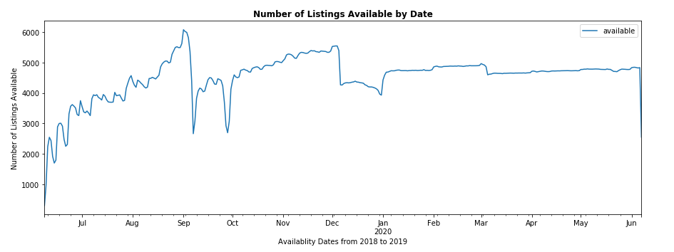
Data Analysis : Finding the Busiest Month By Listing Availability?

Slide 17
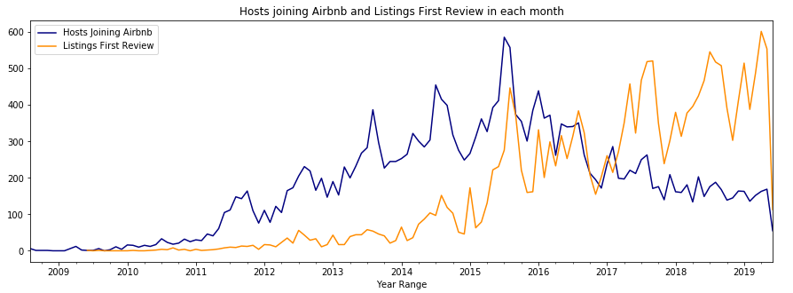
Data Analysis : How Long hosts have been listing their properties?

Slide 18
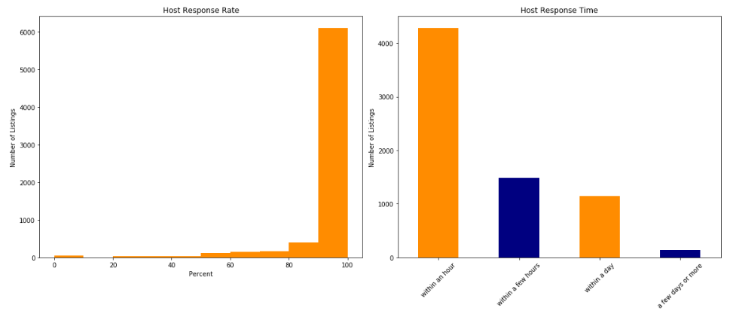
Data Analysis : Judging the Hosts Response ?

Slide 19
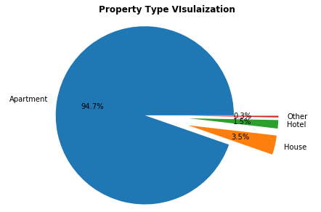
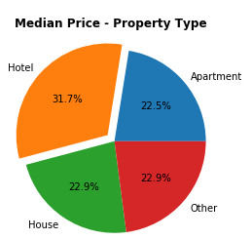
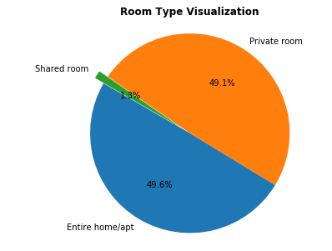
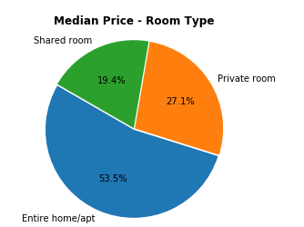
Data Analysis : Property , Room Types Vs Price

Slide 20
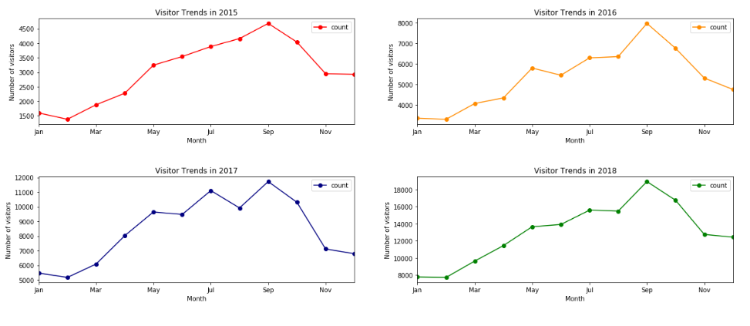
Data Analysis : Visitor Trend Based on Reviews

Slide 21
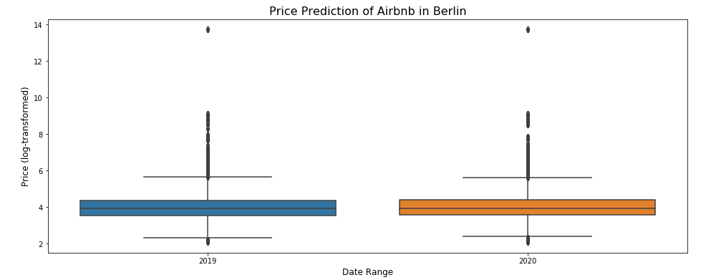
Data Analysis : Future Price Prediction
2019-01-01 🡪 78.20 2020-01-01 🡪 81.65

Slide 22
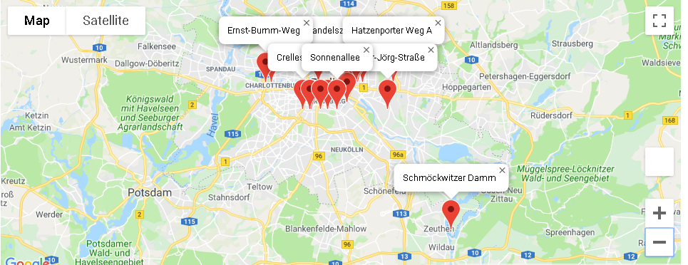
Data Analysis : Top 20 Berlin Airbnb Locations
Based on Property Ratings

Slide 23
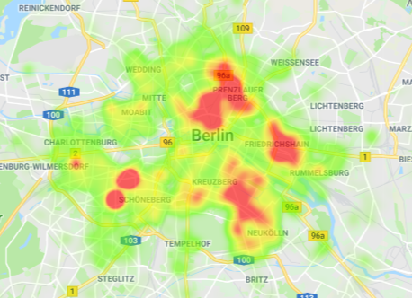
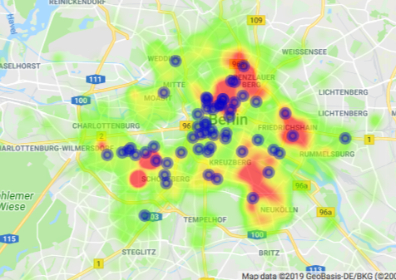
Data Analysis : Top Ratings Restuarants/Café/Bar

Slide 24
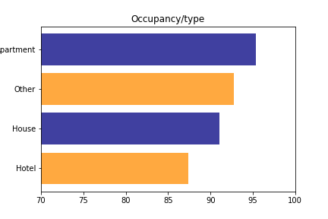
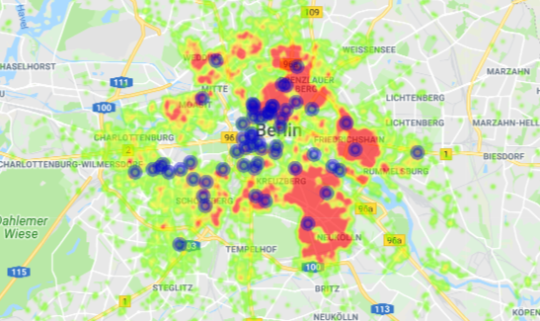
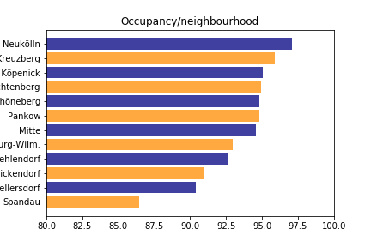
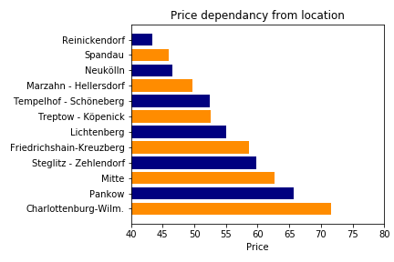
O
C
C
U
P
A
N
C
Y

Slide 25
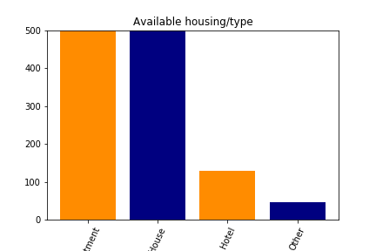
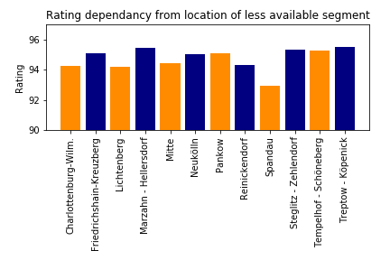
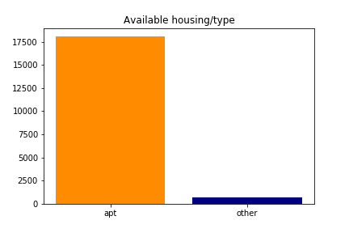
Data Analysis : Availibilty by Housing/Property Type?

Slide 26

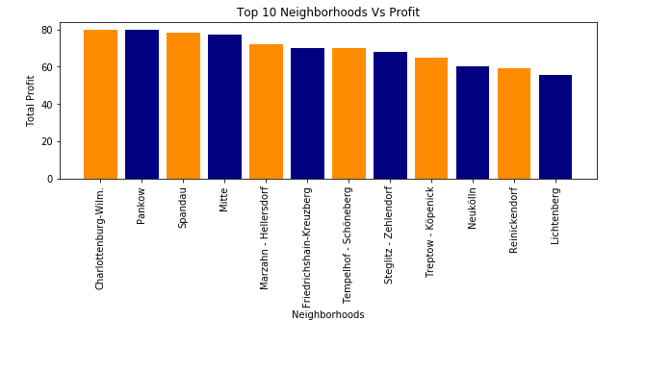
Data Analysis : Neighbourhood Vs Profit

Slide 27
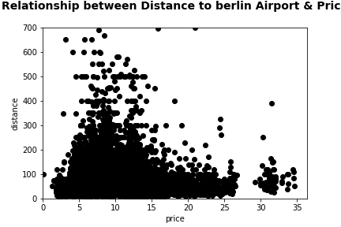
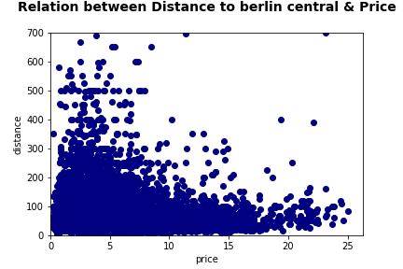
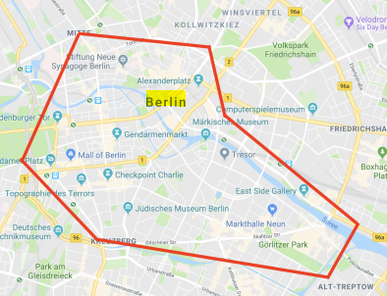
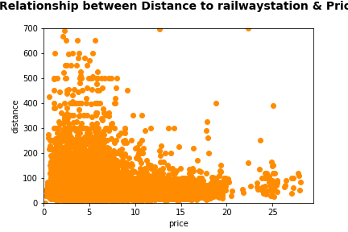
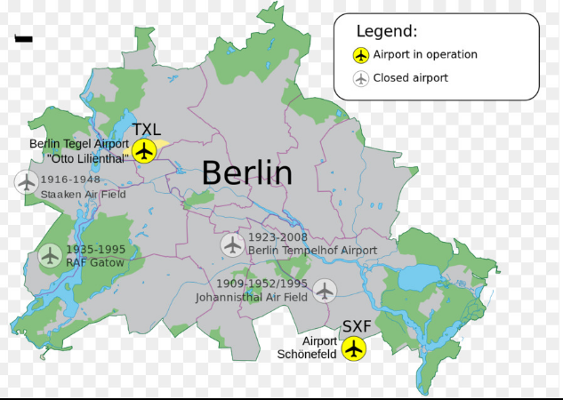
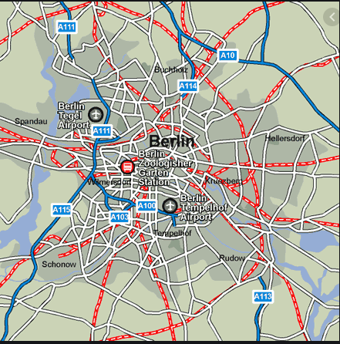
Data Analysis : Distance Vs Price

Slide 28
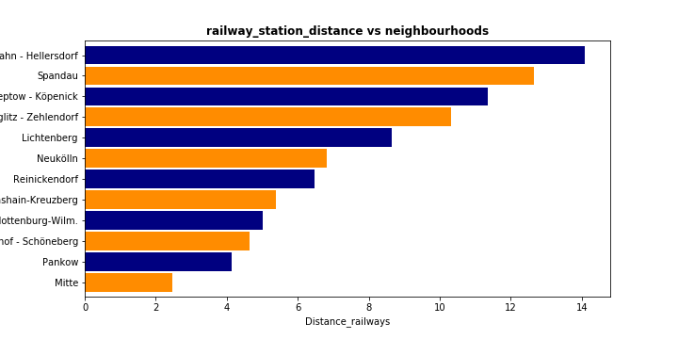


Data Analysis : Distance Vs Neighbourhoods

Slide 29
Outcomes / Take Aways
From Host Perspective,
Wi-Fi, Kitchen, Heating, Essentials and Washer are the most important amenities to be considered for the successful of listing. For those who are already in the business and don't have those amenities, make sure the facility of installing all or some of the amenities to grow your business.
Renting Price based on the Accommodates - Can decide on the rent prices or rent out the property based on neighbourhoods.
Boolean Features Vs Price Correlation – Based on the profit, To decide for the necessity of including these features.
Hosts having more properties will gain higher prices?? – For the Hosts to determine the profits based on the properties.
Judging the Host Response Rate? - For improving their response rate.
Future Price Prediction – For the Hosts to set their prices based on the predicted result.
From Guest Perspective,
Renting Price based on the Accommodates – Choosing the best neighbourhood place according to their budget.
Finding the Busiest Month By Listing Availability? – To plan a trip for a cheaper accommodations (time when less people travel)
Judging the Host Response Rate? – Knowing about the best hosts for ease of communication.
Top 20 Airbnb Listing, Bars, Café, Restaurant based on Ratings, Price, Reviews – For the guests to choose the best based on their preference.
Distance Correlation Vs Price – For the Guests to choose the best place based on their budget and distance factor.
Availability Factor – For the Guests to know the availability of the Property based on Housing types.

Slide 30
Conclusion
From the Berlin Airbnb Data, we can conclude the below points :
The peak/busiest time to travel Berlin would be during their Summer time ( June till Sept) and price range is high during these times based on the listing availability and visitor trends.
With the location of the most popular places and food establishments with the best reviews we marked on the map of Berlin the most comfortable areas for restaurants and bar.
Hotel margins are high due to demand and limited availability.
The accommodation prices are correlated to the distance from the busiest place and distance factor is influencing people renting prices.
The Most top places/restaurants are close to Berlin Central.
The Price change over the time is keep on fluctuating.

Slide 31

Future Work
Implementing the NLP Model for sentiment analysis to work on the Reviews Dataset.
Using Machine Learning Concepts like Word Cloud Generator on the description which can be used to guess the actual price based on similar listings.
Covering more countries to know the actual Airbnb Business strategy.
Building a machine learning model for finding the important features in the dataset.
Work on finding more accurate data of having actual average prices per night or Building a predictive model to predict the base Airbnb prices.
Images attracts people to book the properties– May be
some kind of image processing analysis to predict the
guest choice.
We need to find and analyse housing available for sale in
Berlin and compare it with our comfortable areas.

Slide 32



References
http://insideairbnb.com/berlin/
https://www.dataquest.io/blog/tutorial-time-series-analysis-with-pandas/
https://www.movable-type.co.uk/scripts/latlong.html
https://python.gotrained.com/yelp-fusion-api-tutorial/
https://developers.google.com/places/web-service/search#PlaceSearchRequests

